Slide 1
Deep Learning for Biology
Joris Roels

Slide 2


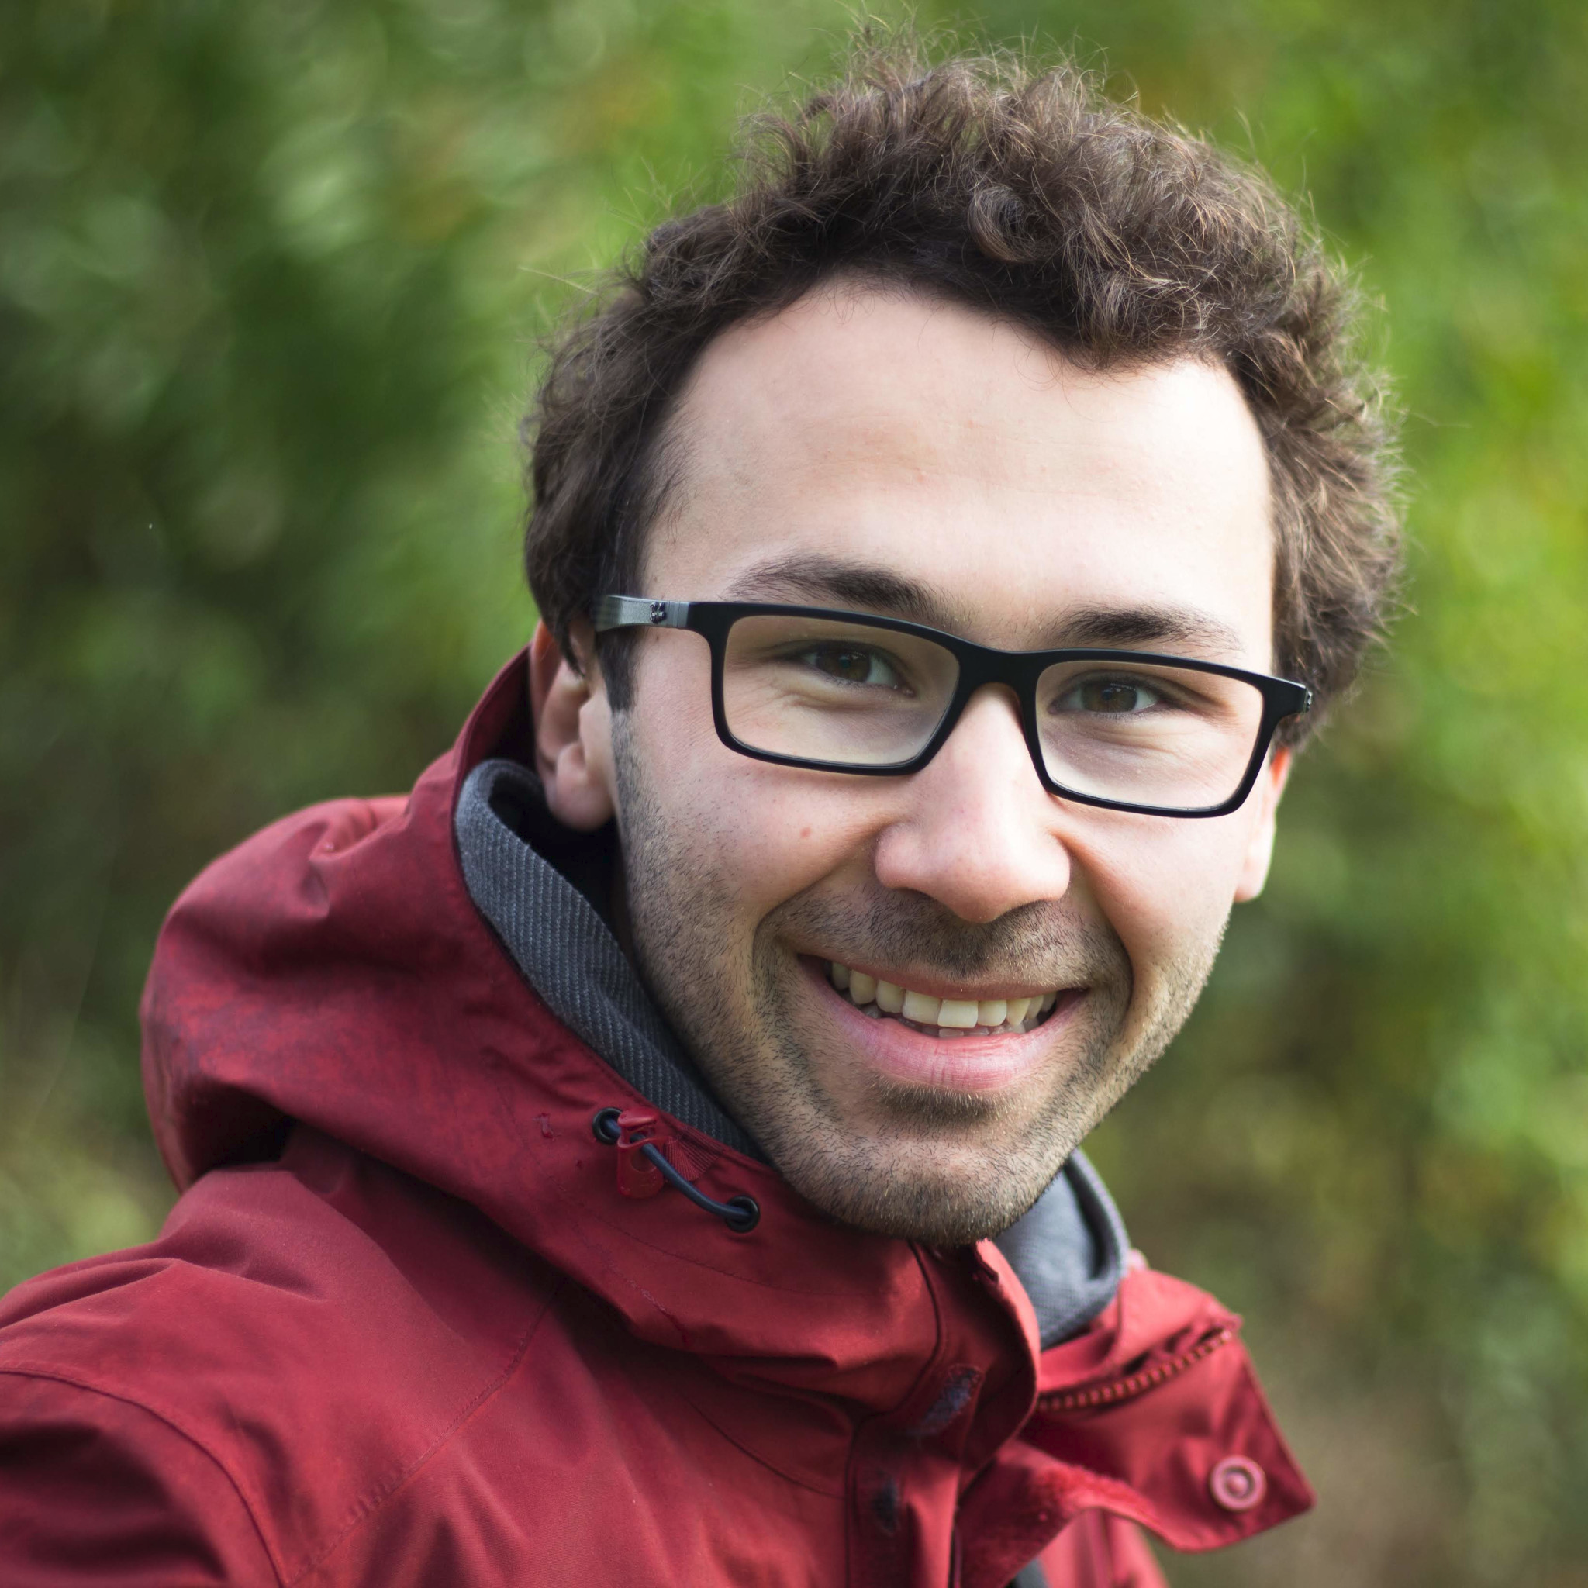
About me...
Joris Roels
PhD since May 2019
Image segmentation of EM images with DL
Visiting researcher at EMBL in 2018
Currently postdoctoral researcher:
Data mining and modeling for biomedicine (Saeys lab, VIB)
Bioimaging Core, VIB
Machine learning techniques for large-scale biomedical image analysis
Contact:
joris.roels@ugent.vib.be
https://jorisroels.github.io/

Slide 3

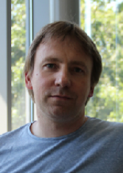

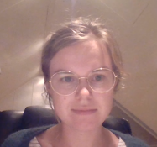

Special thanks…
Practical organization:
Janick Mathys (Bioinformatics Core, VIB)
Assistance exercise sessions:
Frank Vernaillen (Bioinformatics & Bioimaging Core, VIB)
Maxim Lippeveld (Saeys Lab, VIB)
Lotte Pollaris (Saeys Lab, VIB)
Benjamin Rombaut (Saeys Lab, VIB)

Slide 4
Goals of this workshop
Understand the theory behind neural networks
Get acquainted with recent deep learning techniques
What are they capable of?
What are their limitations?
Obtain practical experience with deep learning algorithms
Get familiar with deep learning frameworks
Data pre-processing
Implement deep learning architectures and training
Hyper parameter tuning
Emphasize on biomedical use-cases
You are welcome to use your own data (but let us know)

Slide 5
Practical information
Theory lectures:
In group
Slides
Questions: in the main chat
Exercises:
In group discussion & break-out sessions
Google Colab
Python notebooks
Solved notebooks are also available
All course material available online:
Slides & exercises: https://github.com/JorisRoels/deep-learning-biology
Data: http://data.bits.vib.be/pub/trainingen/DeepLearning

Slide 6

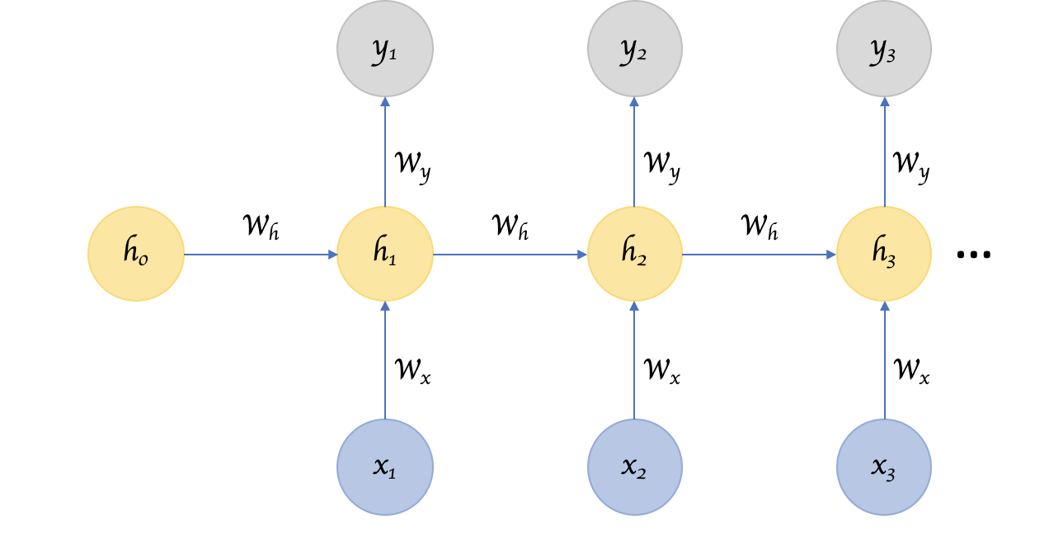
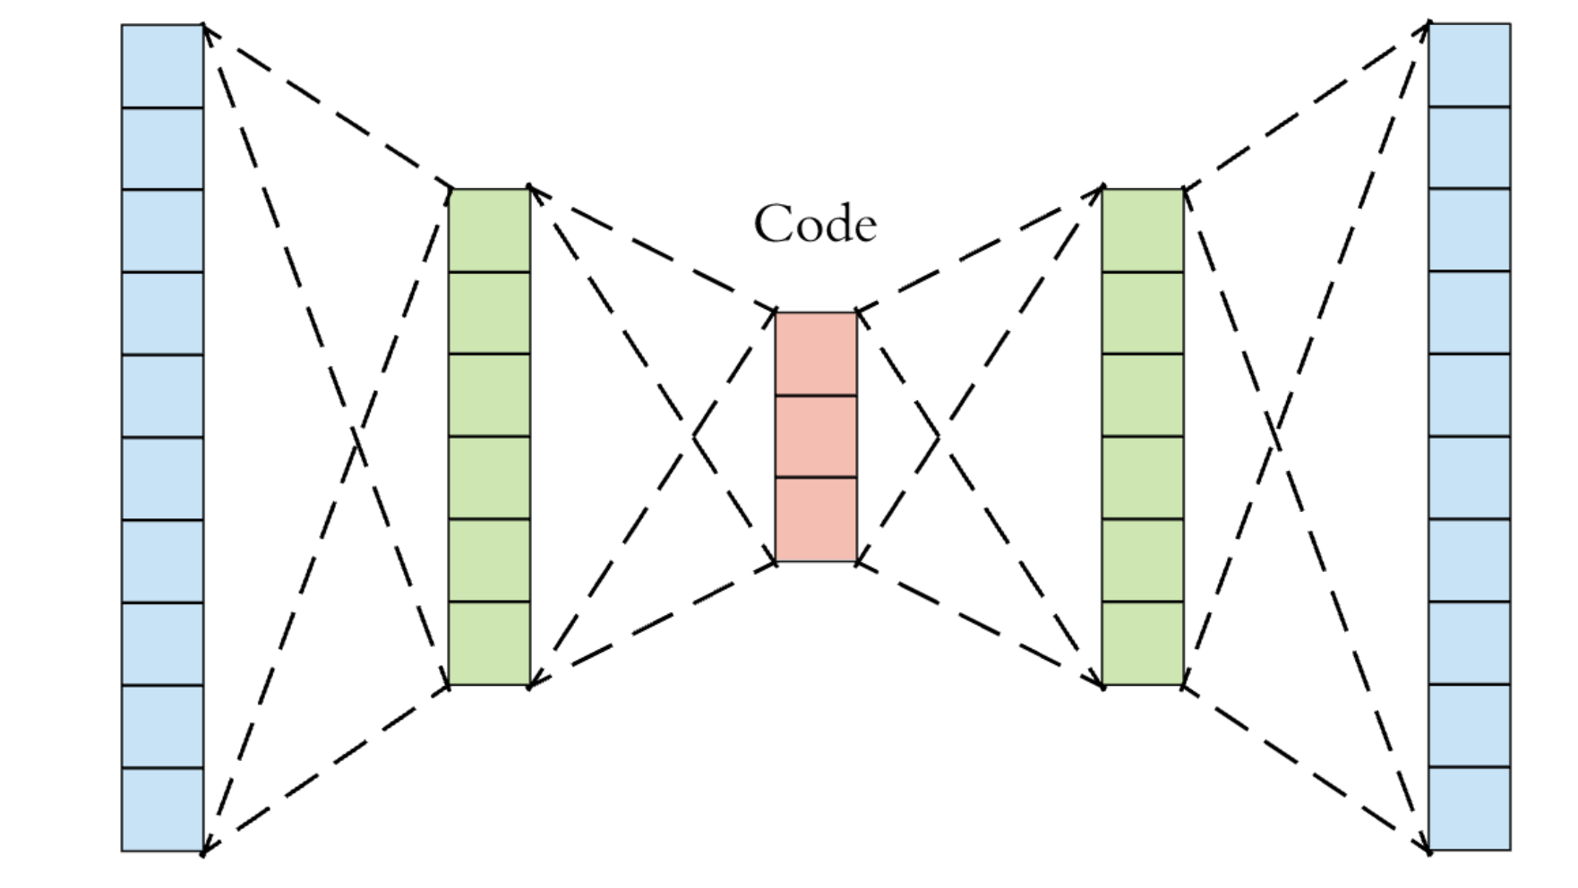


Agenda
Day 1:
Introduction to Deep Learning
Neural Networks
Convolutional Neural Networks for Classification
Day 2:
Convolutional Neural Networks for Segmentation
Recurrent Neural Networks
Unsupervised Neural Networks

Slide 7
DAY 1 |  |  | DAY 2
9:00 | Introduction to Deep Learning |  | 9:00 | Convolutional Neural Networks for Segmentation
9:15 |  |  | 9:15
9:30 |  |  | 9:30
9:45 | Exercises |  | 9:45 | Exercises
10:00 |  |  | 10:00
10:15 |  |  | 10:15
10:30 |  |  | 10:30
10:45 |  |  | 10:45 | Break
11:00 | Break |  | 11:00 | Recurrent Neural Networks
11:15 | Neural Networks |  | 11:15
11:30 |  |  | 11:30
11:45 |  |  | 11:45
12:00 |  |  | 12:00
12:15 |  |  | 12:15
12:30 | Lunch |  | 12:30 | Lunch
12:45 |  |  | 12:45
13:00 |  |  | 13:00
13:15 |  |  | 13:15
13:30 | Exercises |  | 13:30 | Exercises
13:45 |  |  | 13:45
14:00 |  |  | 14:00
14:15 |  |  | 14:15
14:30 |  |  | 14:30
14:45 | Break |  | 14:45 | Break
15:00 | Convolutional Neural Networks for Classification |  | 15:00 | Unsupervised Neural Networks
15:15 |  |  | 15:15
15:30 |  |  | 15:30
15:45 |  |  | 15:45
16:00 | Exercises |  | 16:00 | Exercises
16:15 |  |  | 16:15
16:30 |  |  | 16:30
16:45 |  |  | 16:45

Slide 8
Introduction to Deep Learning

Slide 9
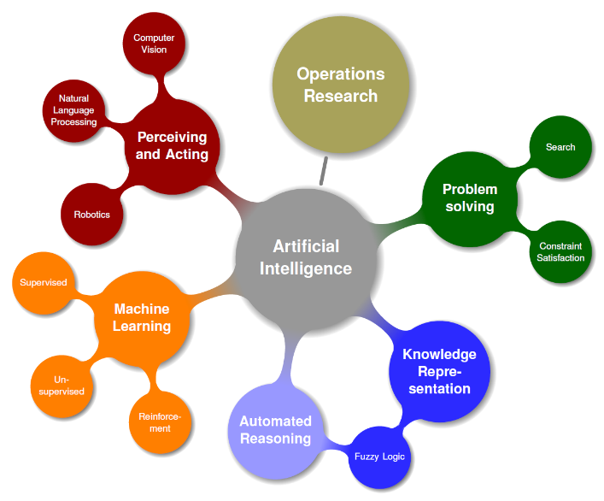
Artificial Intelligence & Machine Learning
Artificial intelligence (AI): simulation of human intelligence in machines that are programmed to think like humans and mimic their actions
Machine learning is only a part of what AI covers
Not all branches are completely distinct
Computer vision & machine learning
Fuzzy logic & robotics
…

Slide 10
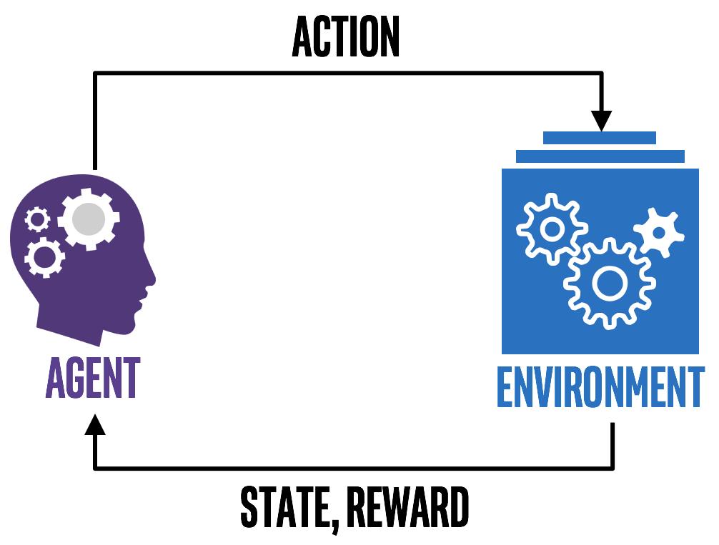
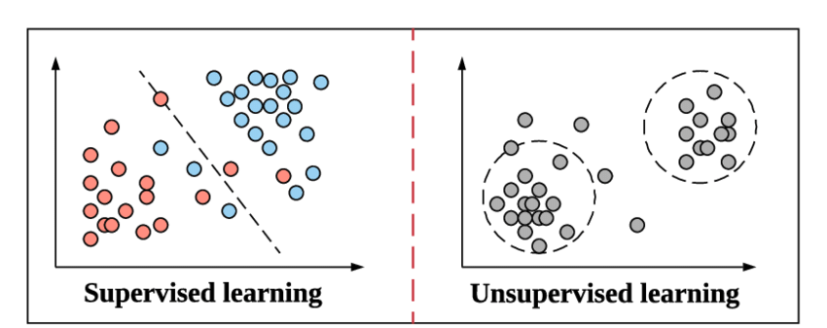
Artificial Intelligence & Machine Learning
Machine learning (ML) is the study of computer algorithms that improve automatically through experience
Reinforcement learning
Unsupervised learning
Supervised learning
Reward oriented decision making
Exploration
Prediction

Slide 11
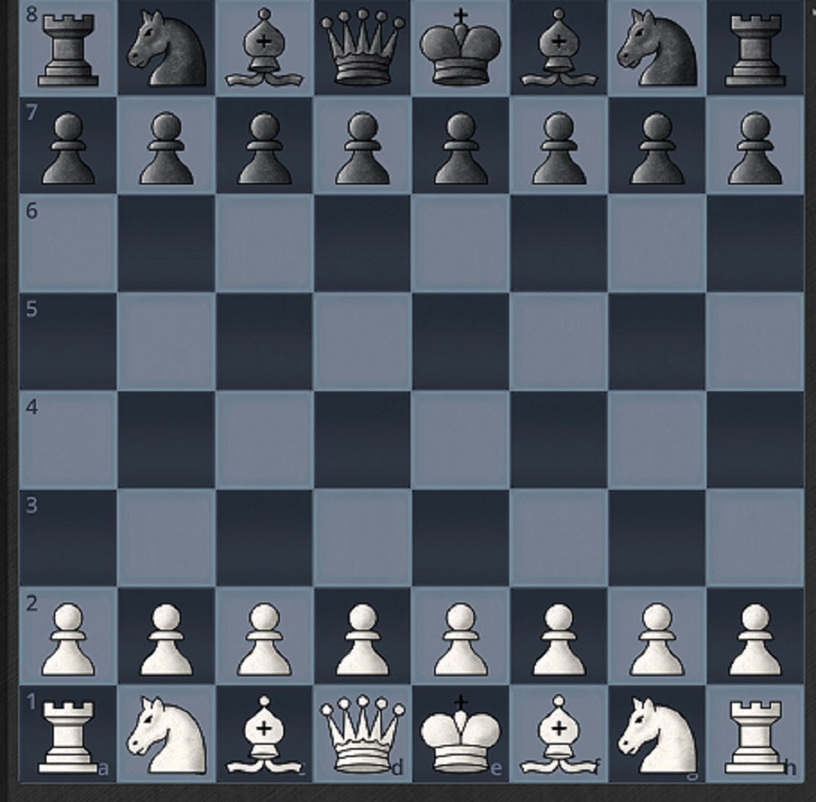

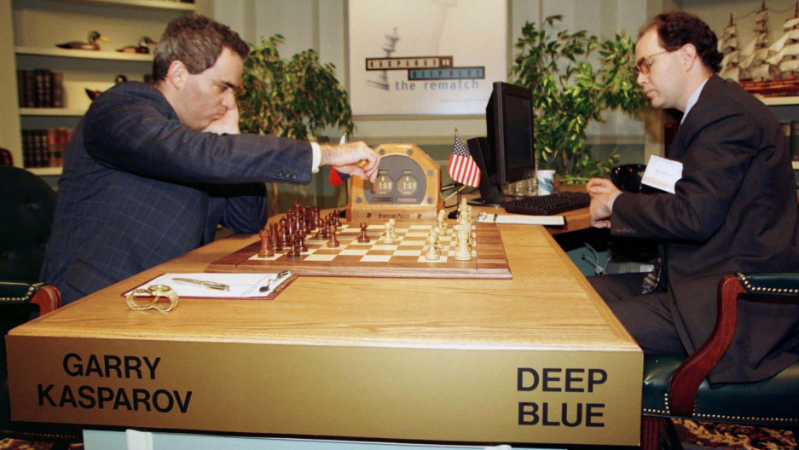
Reinforcement learning
Reward
State
How can an agent take actions in an environment in order to maximize its reward?
Example: Chess
Agent: decision making algorithm
Action: move a piece to a specific position
Reward: destroy as much pieces as possible
State: playing board state
Environment: all possible board states
Action
Agent
Environment
1997: Deep Blue defeats world champion

Slide 12

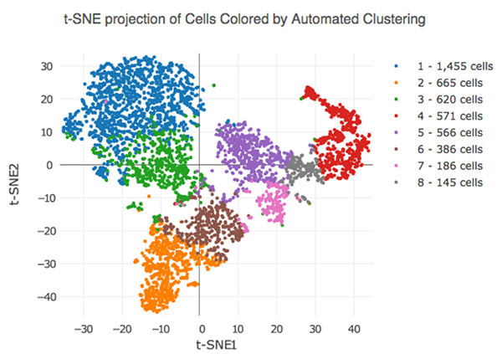
Unsupervised learning
2018: DeepFake
How can we find structure or patterns in data or even generate new data?
Example: single-cell analysis
Dimensionality reduction of the features (genes)
Cell clustering
Potentially find new cell types

Slide 13
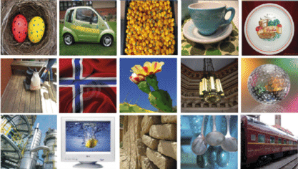
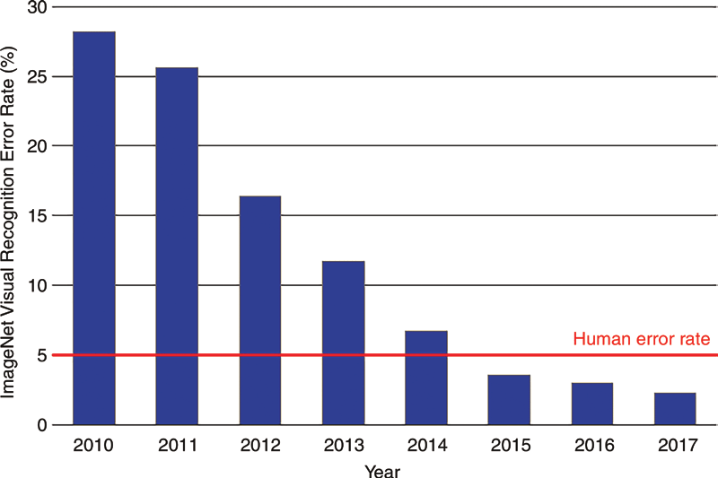
Supervised learning
2015: ResNet outperforms humans in object detection from images
Can we make predictions on data, based on a set of labeled examples?
Example: object detection in images
Annotate a large set of images (ImageNet)
Learn to differentiate between different object classes

Slide 14
Traditional (un)supervised learning
Traditional approaches are based on hand-engineered feature extraction, followed by (shallow) clustering methods or predictors
Feature extraction
Clustering
Regression
Classification
Feature selection
Dimensionality reduction
 | Gene 1 | ... | Gene N
Cell 1 | 0.0 | ... | 0.2
... | ... | ... | ...
Cell M | 0.8 | ... | 0.4

Slide 15
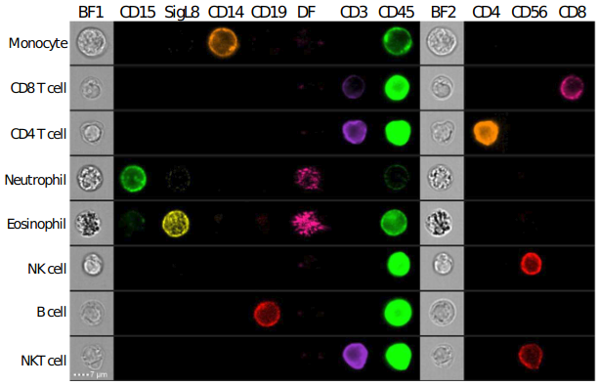
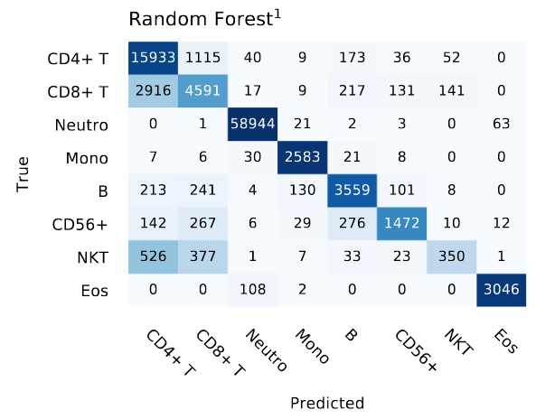
Traditional (un)supervised learning
Traditional approaches are based on hand-engineered feature extraction, followed by (shallow) clustering methods or predictors (Lippeveld et.al., 2020)
Feature extraction
Clustering
Regression
Classification
Stain-free imaging flow-cytometry
Feature selection
Dimensionality reduction
 | Size | Shape | ... | Texture
Cell 1 | 0.0 | 0.1 | ... | 0.2
... | ... | ... | ... | ...
Cell M | 0.8 | 0.5 | ... | 0.4

Slide 16
Traditional (un)supervised learning
Traditional approaches are based on hand-engineered feature extraction, followed by (shallow) clustering methods or predictors
Feature extraction
Clustering
Regression
Classification
Feature selection
Dimensionality reduction
Intensity
Contrast (edges)
Correlation
Texture
Shape
...
k-NN
DBSCAN
Least squares
Decision trees
SVM
...
FCBF
Beam search
PCA
t-SNE
UMAP
...

Slide 17
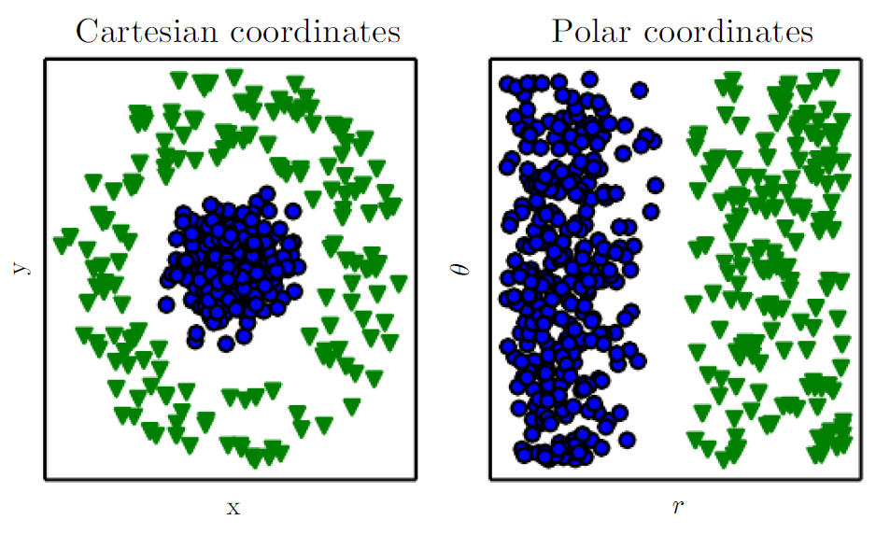
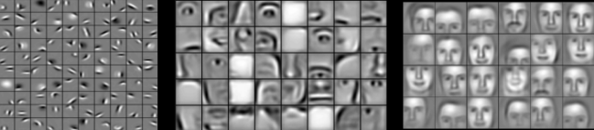
Traditional (un)supervised learning
Limitations of hand-engineered feature extraction:
Which features are most suitable to separate classes/clusters?
⇒ May require domain expertise!
How do we extract more abstract features?
Shape
Partial objects

Slide 18
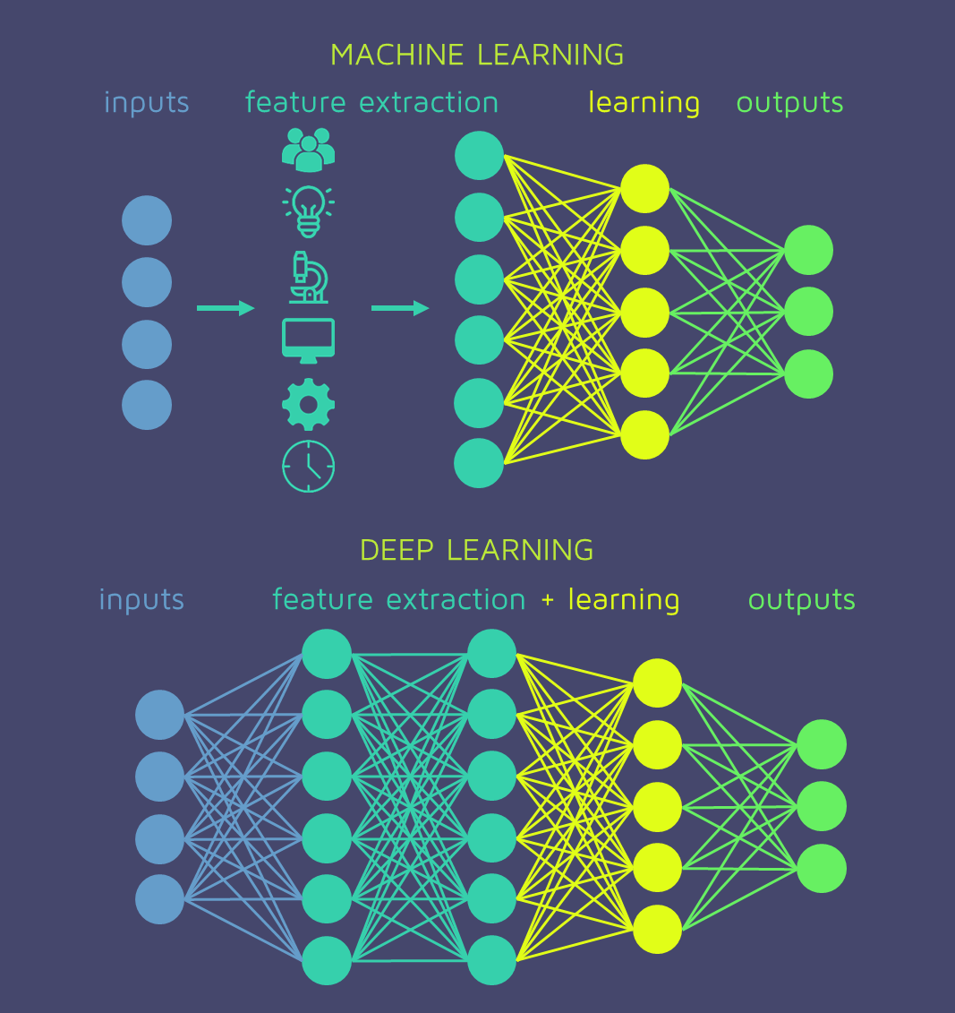
Deep Learning
Automation of feature extraction:
Feature learning instead of “manual” feature extraction
Features are hierarchically represented in layers
Increase the capacity of the model by using many layers

Slide 19
Deep Learning
Reinforcement learning
Unsupervised learning
Supervised learning
Deep
Shallow
Deep
Shallow
Deep
Shallow
Reward oriented decision making
Exploration
Prediction

Slide 20




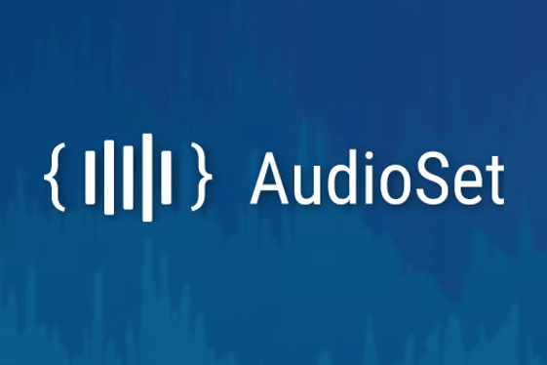


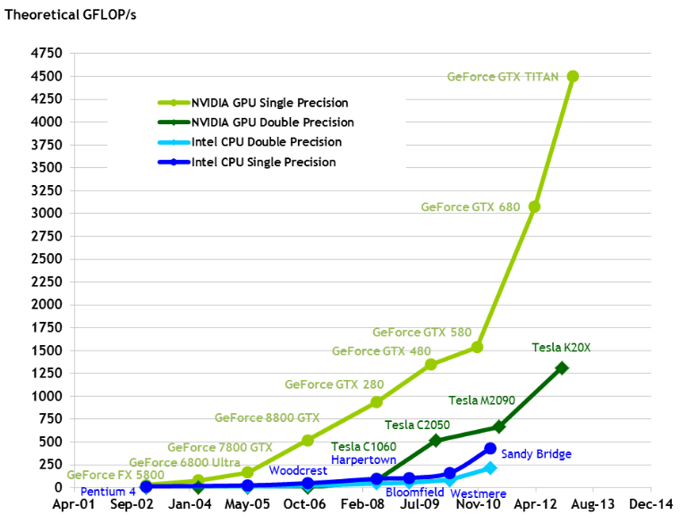

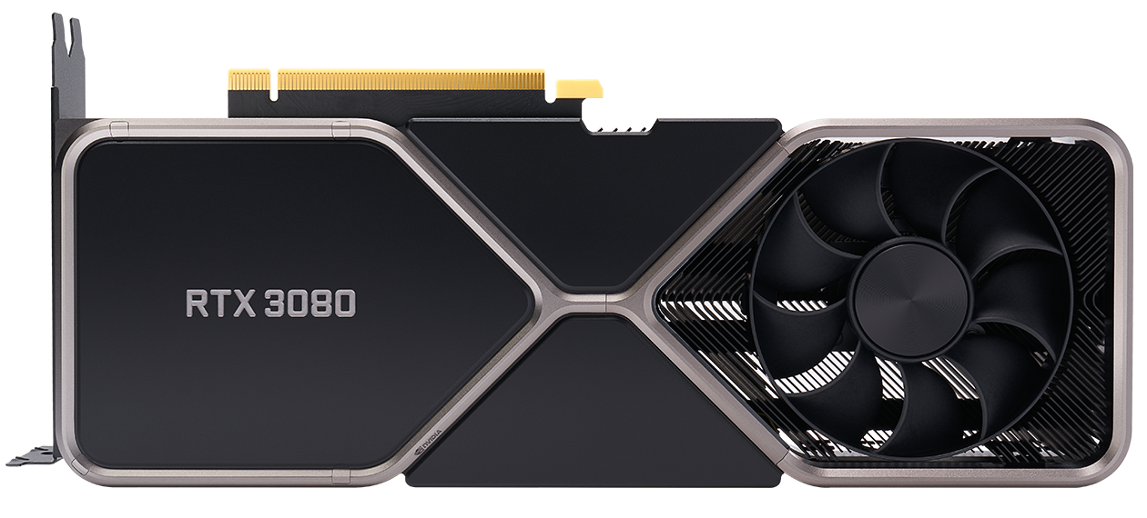
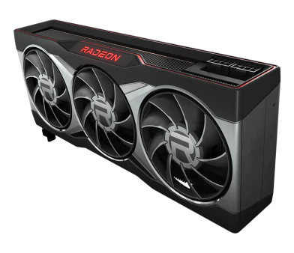

Deep learning
Why haven’t we done this before?
⇒ Two things were missing:
Large amounts of data
ImageNet, AudioSet, ...
Computational resources
Many operations in deep learning techniques can exploit parallel computing (ideal for GPUs)

Slide 21
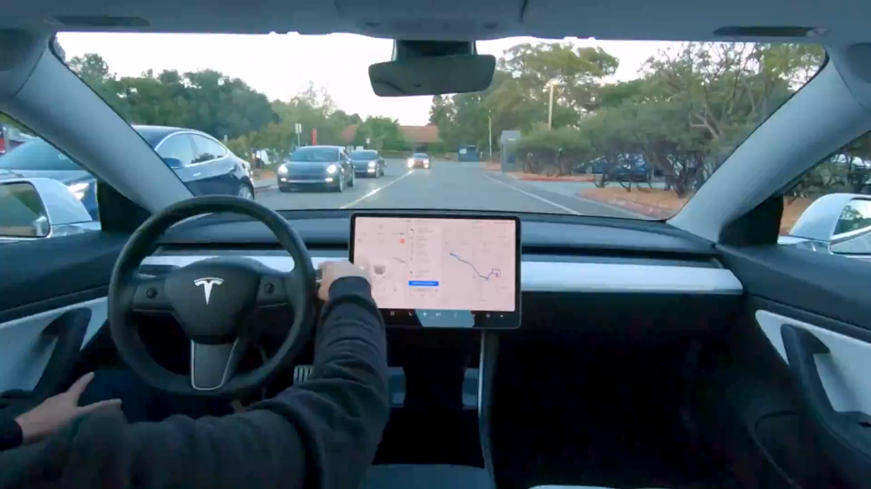
Applications: Autonomous driving

Slide 22
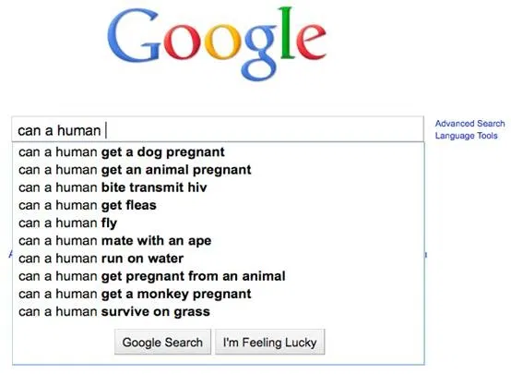
Applications: Google autocomplete

Slide 23
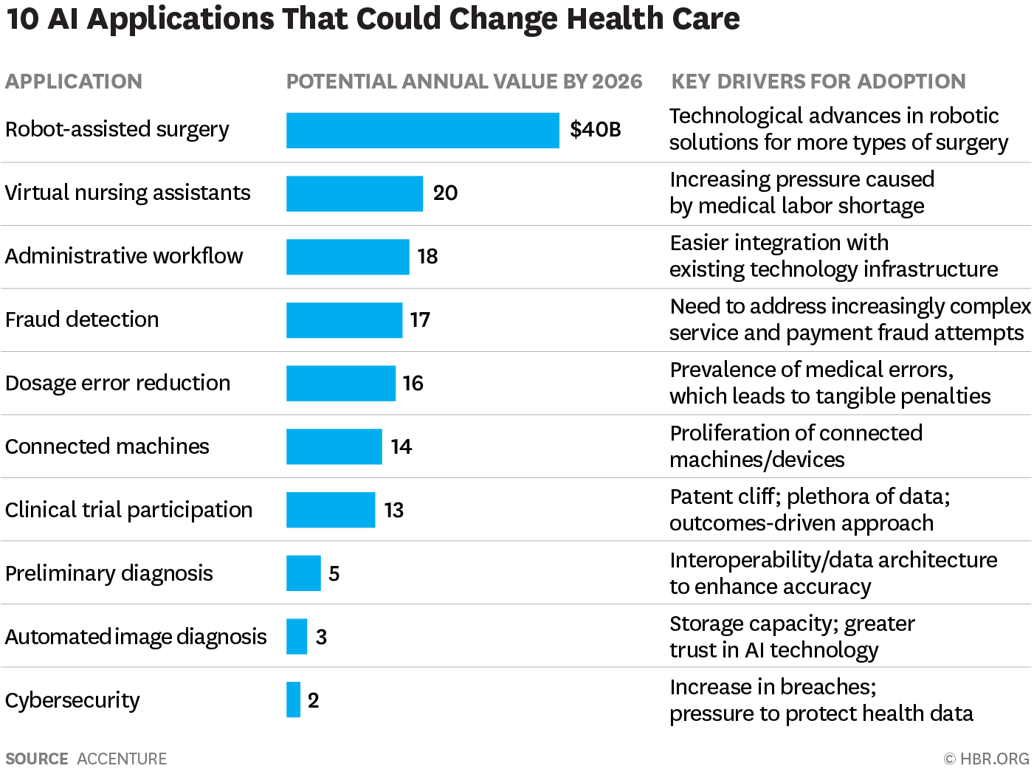
Applications: Health Care

Slide 24
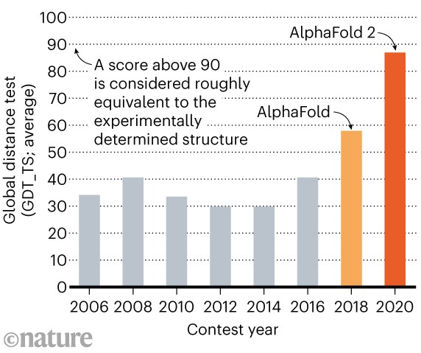
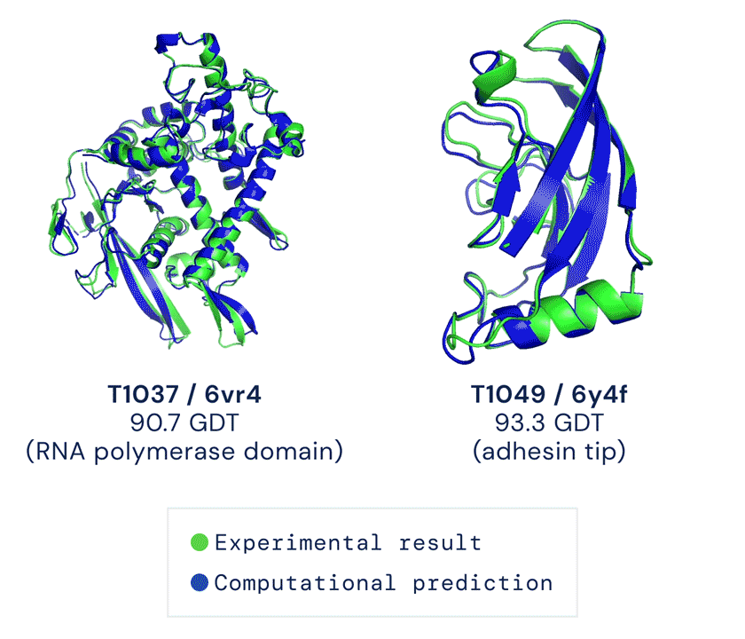
Applications in biology
Protein secondary structure prediction

Slide 25
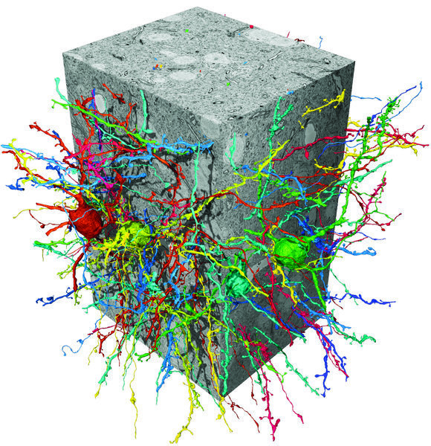
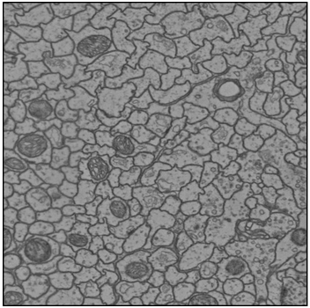
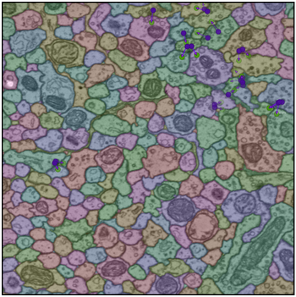
Applications in biology
Neuron reconstruction in brain EM data (Januszewski et.al., 2019)

Slide 26
Deep learning: pros & cons
State-of-the-art performance in most domains
Existing frameworks make implementation relatively easy
Keras
TensorFlow
PyTorch
Large user-community
Code
Data
Pre-trained models
Requires lots of (labeled) data!
Computationally expensive
Typically requires GPU(s)
Training can be time-consuming
Model finetuning requires expertise
Extracted features are hard to interpret
Still lacking some theoretical fundaments

Slide 27
Exercises

Slide 28





Deep learning frameworks
There exist many frameworks for deep learning (mostly Python)
PyTorch
TensorFlow
Keras
Caffe
Theano
…

Slide 29

Machine learning framework
GPU acceleration: alternative for numpy
Open source
Python
Easy to install: https://pytorch.org/get-started/locally/
Large user community (especially research)
Automatic differentiation
Lots of flexibility
Lots of tutorials: https://pytorch.org/tutorials/
60-min blitz is highly advised!
Well-documented: https://pytorch.org/docs/stable

Slide 30

Google Colab
If you want to work locally, make sure to check the first section of the first exercise session!
Compute environment: Google Colaboratory (Colab)
Write/execute Python code through the browser
Well suited to machine learning, data analysis and education
Jupyter notebooks
Virtual machines:
No setup required
Most drivers and Python libraries installed
Free use of resources
GPU (NVIDIA K80, T4, P4 and P100) & TPU
12 GB RAM
12 hours compute time / session
If you have question about Colab: ask us, or check the FAQ: https://research.google.com/colaboratory/faq.html

Slide 31
Exercises
Open the notebook in Google Colab:
https://colab.research.google.com/github/JorisRoels/deep-learning-biology/blob/main/exercises/assignments/dlb-0-neural-networks.ipynb
Make sure you are using a GPU: Runtime > Change Runtime Type > Select ‘GPU’
Move to your break-out room
Ask questions to the assistants in the break-out room!

Slide 33
References
Ching, T., Himmelstein, D. S., Beaulieu-Jones, B. K., Kalinin, A. A., Do, B. T., Way, G. P., Ferrero, E., Agapow, P. M., Zietz, M., Hoffman, M. M., Xie, W., Rosen, G. L., Lengerich, B. J., Israeli, J., Lanchantin, J., Woloszynek, S., Carpenter, A. E., Shrikumar, A., Xu, J., … Greene, C. S. (2018). Opportunities and obstacles for deep learning in biology and medicine. Journal of the Royal Society Interface, 15(141). https://doi.org/10.1098/rsif.2017.0387
Lippeveld, M., Knill, C., Ladlow, E., Fuller, A., Michaelis, L. J., Saeys, Y., Filby, A., & Peralta, D. (2020). Classification of Human White Blood Cells Using Machine Learning for Stain‐Free Imaging Flow Cytometry. Cytometry Part A, 97(3), 308–319. https://doi.org/10.1002/cyto.a.23920
Januszewski, M., Kornfeld, J., Li, P. H., Pope, A., Blakely, T., Lindsey, L., Maitin-Shepard, J., Tyka, M., Denk, W., & Jain, V. (2018). High-precision automated reconstruction of neurons with flood-filling networks. Nature Methods, 15(8), 605–610. https://doi.org/10.1038/s41592-018-0049-4

